Slide 1
BH Astrophys. Ch3.6

Slide 2
Outline
1. Some basic knowledge about GRBs
2. Long Gamma Ray Bursts (LGRBs)
- Why so luminous?
- What’s the geometry?
- The life stages
- The supernova connection
- The collapsar model
3. Short Gamma Ray Bursts (SGRBs)
4. Other types of GRBs
- Ghosts
- X-ray flashes
- Low Energy GRBs

Slide 3
Outline
1. Some basic knowledge about GRBs
2. Long Gamma Ray Bursts (LGRBs)
- Why so luminous?
- What’s the geometry?
- The life stages
- The supernova connection
- The collapsar model
3. Short Gamma Ray Bursts (SGRBs)
4. Other types of GRBs
- Ghosts
- X-ray flashes
- Spectral lag GRBs
- Low luminosity GRBs

Slide 4
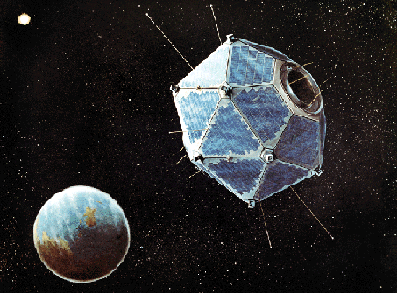
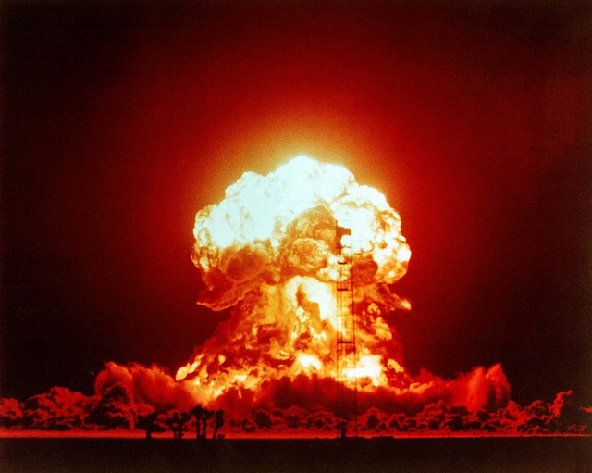
Pre Compton Era – The Vela satellites (1967~1990)
© Gerald Simmons
© NASA
Questions of the era:
What are these flashes?
Where do they come from? Extragalactic? Galactic?

Slide 5
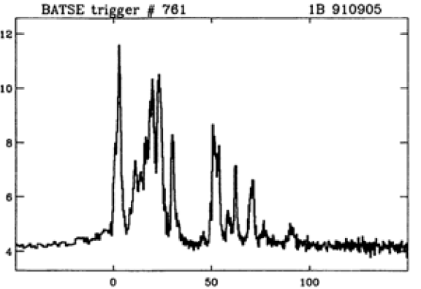
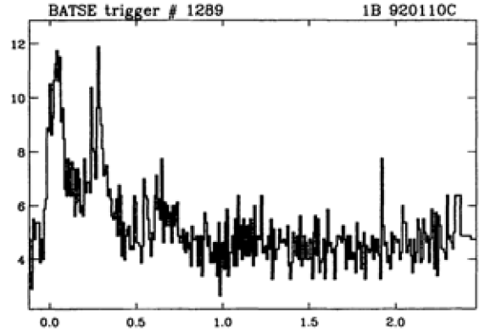
The long and short GRBs
LGRBs
SGRBs

Slide 6
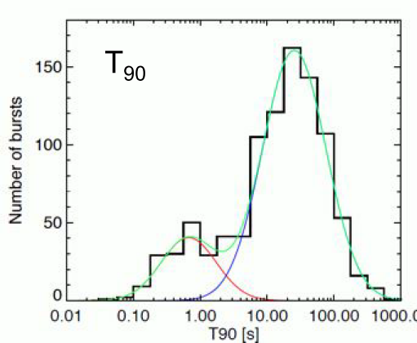
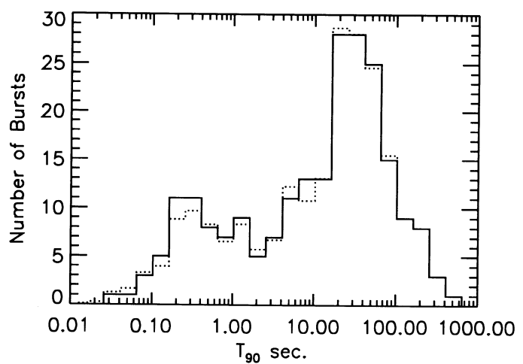
The (common) classification
Situation in 1993
Situation in 2012
Short Bursts ~0.3s
Long Bursts ~30s
2s divide
#= 58
#= 164
C. Kouveliotou ApJ, 413, L101 (1993)
Fermi+ 2012
Bimodal distribution with a divide at 2 sec！
Possibly two different classes of objects causing the bursts.
5%
90%
5%
$$T_{90}$$
N.Gehrels & P.Meszaros Science, 337, 932 (2012)
Notes:
T90 means that the time during the cummulative counts increase from 5% to 95%
More data using the Fermi telescope clearly indicates that the two classes respectively follow a bimodal distribution.
Explaining the number difference: possibly due to luminosity difference thus results Due to instrument effects (Phys. Reports 442,166)

Slide 7
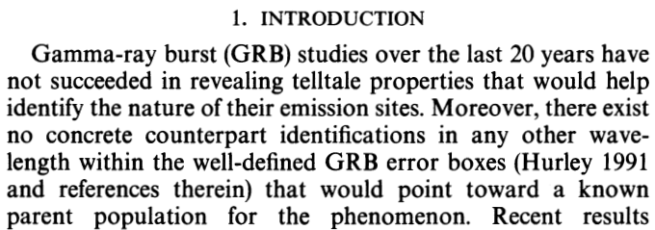
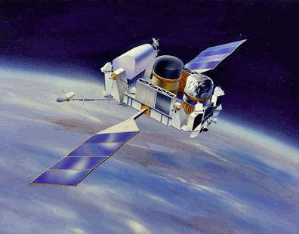
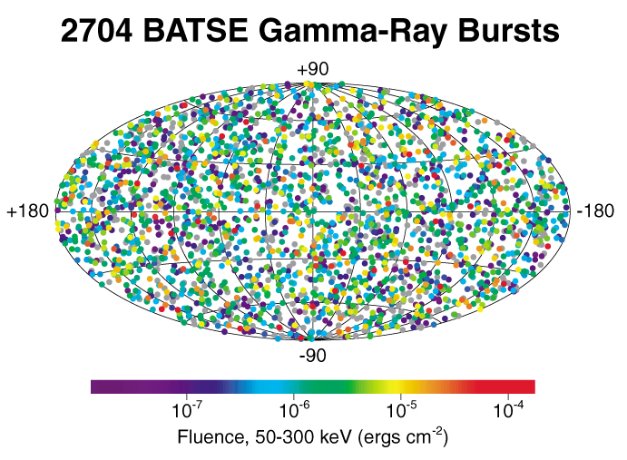
The situation as of 1993
C. Kouveliotou ApJ, 413, L101 (1993)
© NASA
http://gcn.gsfc.nasa.gov/
More likely to be extra-galactic！
The counterpart in other wavelengths?
© NASA

Slide 8
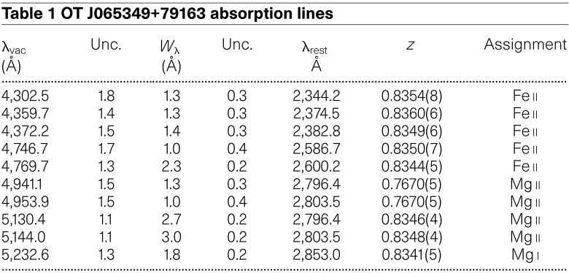
GRB 970508 First direct evidence of extragalactic origin
Metzger, M., et al., 1997, Nature, 387, 878
Measured optical counterpart to be at z ~ 0.835
OT flux overriding the host
June 1997 HST/STIS
Host revealed as actively star forming galaxy
At such distances, the isotropic luminosity would be huge! ~${10}^{52}$ergs/s! Way brighter than any Supernova!
Aug 1998 HST/STIS
For quick reference : http://www.mpe.mpg.de/~jcg/grb970508.html
Notes:
Why can we attribute the GRB to the galaxy? Within the error box, the optical transient is the only thing. Arguments provide that any reasonable galaxy brightness would be outshown by the OT at this redshift.
Discussion about the radio variability arising from different reasons such as from ISS is discussed in the article but isn’t the main focus of the presentation.
*Optical transient measurements have of course also been carried out for this source, but due to limited time…

Slide 9
Outline
1. Some basic knowledge about GRBs
2. Long Gamma Ray Bursts (LGRBs)
- Why so luminous?
- What’s the geometry?
- The life stages
- The supernova connection
- The collapsar model
3. Short Gamma Ray Bursts (SGRBs)
4. Other types of GRBs
- Ghosts
- X-ray flashes
- Spectral lag GRBs
- Low luminosity GRBs

Slide 10
LGRBs—Why so luminous?
The puzzle
Observed:
Small size
+
high γ-ray flux
+
optically thin synchrotron emission
Photon-photon interaction should produce $e^{−},e^{+}$ pairs that thermalize the plasma
Optically thick thermal spectrum
What happened ?
LGRBs
Bohdan Paczy´nski , Peter M´esz´aros, Martin Rees showed that observations were consistent with an optically thin fireball of $e^{−},e^{+},B field$ expanding at Γ~300 (0.999995c) !
Turbulence from interaction with external medium
Fast variations?
Irregularities in the outflow
Engine sputtering
These internal shocks slow the flow as they convert kinetic energy into accelerated particles and γ-rays

Slide 11
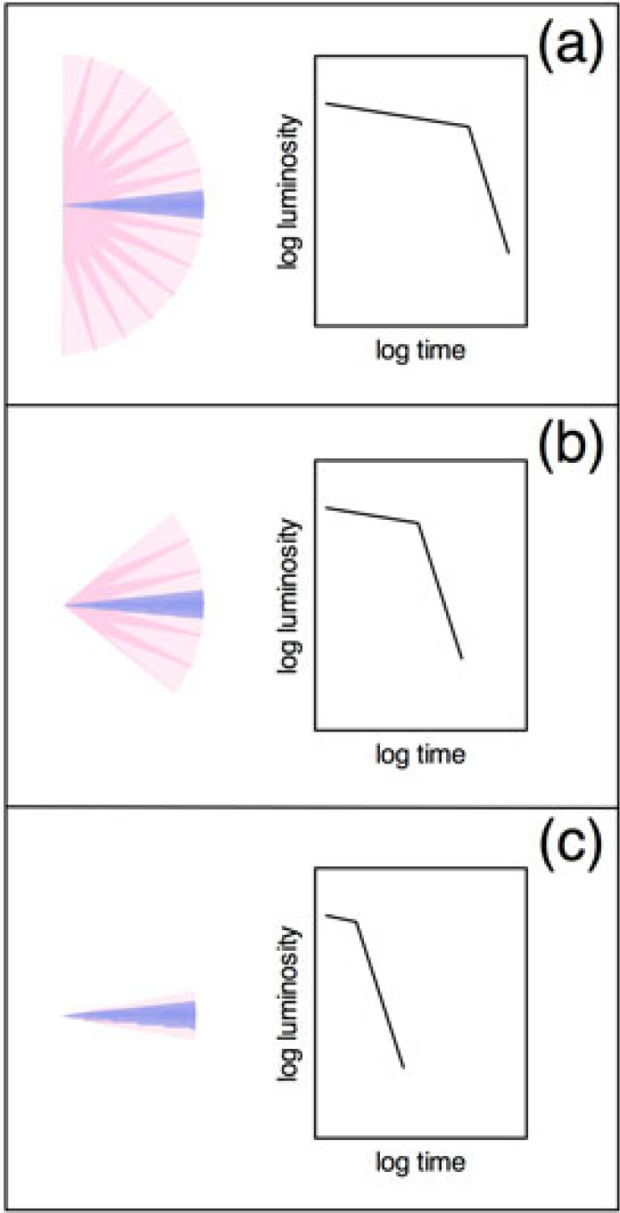
LGRBs—What’s the geometry?
Spherical ?
Cone shaped?
High Γ factor
Confined view of emission
Hemispherical ?
Jet?
Beaming breaks
F$∝t^{−1.1}$
F$∝t^{−2}$
The case of GRB 990123 showed a beaming break at around 2 days, indicating the original flow angle is ~$6^{°}$
This reduces the required luminosity in γ-rays to ${10}^{51}$ erg/s similar to strong SNs (this holds true for almost all LGRBs)
This also implies that there are a lot of GRBs hidden from us due to beaming effects!

Slide 12
Outline
1. Some basic knowledge about GRBs
2. Long Gamma Ray Bursts (LGRBs)
- Why so luminous?
- What’s the geometry?
- The life stages
- The supernova connection
- The collapsar model
3. Short Gamma Ray Bursts (SGRBs)
4. Other types of GRBs
- Ghosts
- X-ray flashes
- Spectral lag GRBs
- Low luminosity GRBs

Slide 13
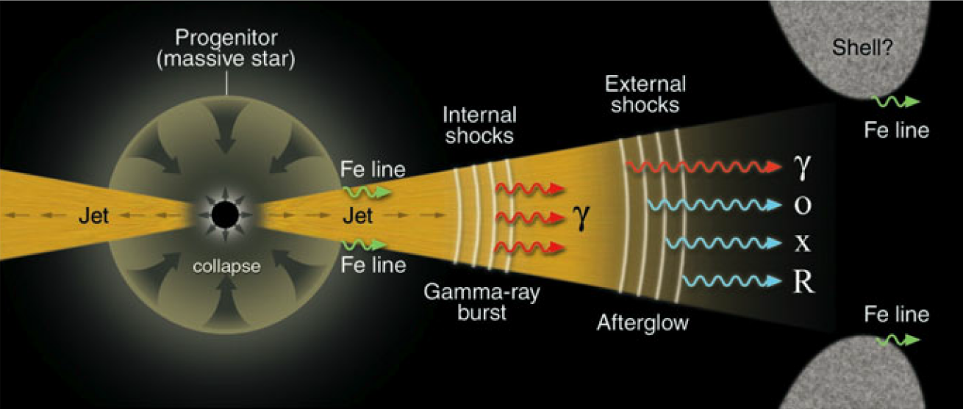
LGRBs—Life stages
1. Inner Engine Activity. In the first few seconds of the initial explosion, a relativistic jet flow is generated by some means deep in the heart of the GRB central engine. The engine varies (“sputters”) on a time scale δt of milliseconds or less, but stays turned on for the duration T of the GRB (up to several minutes). So, the size of the engine is less than 3 × ${10}^{7}$ cm, but the jet outflow itself can be much longer, L = c T ≈ ${10}^{13}$ cm or about 1 AU This large ratio of engine “on” time to dynamical time is typical of the other jet sources we have discussed in this and previous chapters. It indicates that the actual engine event is not explosive at all, but rather a relatively benign, quasi-stationary process.

Slide 14
LGRBs—Life stages
2. Energy Transfer Phase. When the jet flow starts out near the engine, it is not necessarily initially traveling at ultra-relativistic speeds. Instead, it probably is accelerated to the observed speeds (Γ jet ∼ 300) over distances considerably greater than ${10}^{7}$ cm. During its journey from ${10}^{7}$to ${10}^{13}$cm, the jet material is optically thick to γ-rays. These photons interact, produce e + e− pairs, and come into thermal equilibrium with those pairs. Because thermal emission from the surface of the jet is not very bright, the GRB will not visible to observers in this stage. The opening angle of the jet will be θ ∼ 0.1 radians, so its width in the outer portion of the jet will be about ${10}^{12}$cm.

Slide 15
LGRBs—Life stages
3. Gamma-Ray Burst Phase. Beyond ${10}^{13}$cm, the jet becomes optically thin to pair production and releases its γ-rays in the direction of the relativistic flow. The irregular nature of the engine creates internal shocks in the jet that accelerate the electrons and positrons. Those particles, in turn, generate relativistic synchrotron emission that ultimately dissipates much of the kinetic energy in the flow. The jet therefore slows down to $γ_{jet}^{}$∼ 10 at a distance of R ∼ ${10}^{15}$cm – one (light-) day after the initial engine began firing. Initially, when the jet has reached only ${10}^{13}$ cm, we see only a portion of the jet $π{γ_{jet}^{}}^{−2}$∼ 3 × ${10}^{−5}$steradians in solid angle. However, as it decelerates this increases to π$θ^{2}$ ∼ 3 × ${10}^{−2}$ steradians by the time the jet reaches ${10}^{15}$cm. At that point, it also is like a bullet in its rest frame, with a length of $γ_{jet}^{}cT$ and a width $Rθ$ that are about the same size, ${10}^{14}$cm. In our rest frame, however, we see it as a flying pancake only ${10}^{13}$cm thick. Also at this point, θ ∼ ${γ_{jet}^{}}^{−1}$, and the optical light begins to decrease faster.

Slide 16
LGRBs—Life stages
4. Afterglow Phase. The flow now enters an expansion phase, where it expands sideways at nearly c. The external (bow) shock created by the jet heats the interstellar medium as it sweeps it up, generating X-rays and optical emission that decay rapidly at a rate of ∼ $t^{−2}$ . In the late stages of this expansion phase, some GRBs show radio emission that initially scintillates, due to the scattering of the light from this point source by interstellar turbulence in our own Galaxy. After about 1 month, the scintillation ceases, indicating expansion to a size of about ${10}^{17}$cm (one light-month). This is independent confirmation that the jet flow in GRBs is relativistic. During the expansion phase the flow decelerates to sub-relativistic speeds, expands to ∼ ${10}^{16}$cm laterally, but only cT ≈ ${10}^{13}$cm thick in its direction of motion. (Why?) This non-relativistic flying pancake now acts like a portion of an expanding supernova shell, sweeping up more material and becoming unstable and turbulent. Eventually it is halted altogether.

Slide 17
Outline
1. Some basic knowledge about GRBs
2. Long Gamma Ray Bursts (LGRBs)
- Why so luminous?
- What’s the geometry?
- The life stages
- The supernova connection
- The collapsar model
3. Short Gamma Ray Bursts (SGRBs)
4. Other types of GRBs
- Ghosts
- X-ray flashes
- Spectral lag GRBs
- Low luminosity GRBs

Slide 18
LGRBs—the Supernova connection
Mostly found in star-forming galaxies.
The jets have energies comparable to SN
Do all SNs produce LGRBs ?
Are all LGRBs associated with SN?
Most likely No!
GRB observed rate ~1/${10}^{6}$yr
Most likely Yes?
Examples:
GRB actual rate ~1/${10}^{3}$yr
GRB 980425 ⬄ SN 1998 bw
1. z~0.0086 (only 34 Mpc) would make the SN easily detectible.
2. SN is of type Ic-BL which is the SN with much greater energy than typical Type Ib/c.
SN rate ~1/50-100 yr
~1/10 of SNs!
GRB 011121 ⬄ SN 2001ke
Shows re-brightening of optical light curve ~1month after burst → The optical luminosity of the SN was still increasing while the GRB afterglow was already fading.
*More likely associated with Type Ib/c-BL
*high Γ factor indicate accompanying formation of BH instead of NS.

Slide 19
LGRBs—the collapsar model
For some reason the SN fails to explode
Mantle rains down on the proto-neutron star (PNS).
After hours~days
PNS passes 1.5$M_{⨀}$ and collapses to a BH.
Disk is formed from the mantle material.
Neutrino emission and jets form.

Slide 20
Outline
1. Some basic knowledge about GRBs
2. Long Gamma Ray Bursts (LGRBs)
- Why so luminous?
- What’s the geometry?
- The life stages
- The supernova connection
- The collapsar model
3. Short Gamma Ray Bursts (SGRBs)
4. Other types of GRBs
- Ghosts
- X-ray flashes
- Spectral lag GRBs
- Low luminosity GRBs

Slide 21
SGRBs—mergers?
Basic mechanism (same idea as LGRBs):
BH formation → rapid accretion → jet flow → brief fireball
Why are they short?
Less available material for accretion, 100~1000 times less
Maybe NS-NS, NS-BH mergers?
Only material available in this case is small amounts of stuff from SN outer layers.
Should be found in galactic halos, not SF regions.
GRB 050509 detected by Swift was able to be determined to be in a elliptical galaxy at z~0.225, exactly what was expected by merger scenario.
Good targets for gravity wave detectors.

Slide 22
GRB 050709 produced an optical afterglow, but it was located in a z=0.16 SF galaxy, which is still consistent with the merger model as binaries can exist in all types of galaxies.
Optical afterglow is consistent with this SF galaxy having more ISM for the jet to blast into.
A surprising pattern:
their energies are only ${10}^{48−49}$ erg (~300 less than LGRB)
Some SGRBs are highly beamed, relativistic jets.
Consistent with formation of a “bare” black hole: no SN envelope around the engine to collimate the burst
Some SGRBs are just sprays of r-ray emitting material.

Slide 23
A high z population (z=0.4~1.1) are seen as well (~1/3 of all SGRBs), which again is consistent with the NS-NS merger model (?)
The distant SGRBs are intrinsically more energetic than their low-redshift counterparts.
They produce typical ${10}^{48−49}$ erg bursts but we only see those that are highly beamed toward us.
The numbers of distant SGRBs must be considerably more than we see.

Slide 24
Outline
1. Some basic knowledge about GRBs
2. Long Gamma Ray Bursts (LGRBs)
- Why so luminous?
- What’s the geometry?
- The life stages
- The supernova connection
- The collapsar model
3. Short Gamma Ray Bursts (SGRBs)
4. Other types of GRBs
- Ghosts
- X-ray flashes
- Spectral lag GRBs
- Low luminosity GRBs

Slide 25
Other Types of GRBs—Ghosts
LGRBs studied at other wavelengths
90% have X-ray detection
50% have Optical detection
40% have no Optical detection
called “Ghosts”
Possibilities:
1. The exploding massive star may be enshrouded in dense, dusty molecular clouds opaque to optical.
2. GRBs may occur in ULIRGs.
3. They may be low G sources and rapidly decay.
4. They might be at very high z (>10)

Slide 26
Other Types of GRBs—X-ray flashes
Emission mainly in X-rays with weaker accompanying γ-ray emission.
Possibilities:
Many are also ghosts.
1. The exploding massive star may be enshrouded in dense, dusty molecular clouds opaque to optical.
2. GRBs may occur in ULIRGs.
3. They may be low G sources and rapidly decay.
4. They might be at very high z (>10)
+
5. They are heavily loaded with protons and therefore are only mildly relativistic fireballs. (synchrotron emission ~100 lower in energy)
It is generally believed that there are a continuum of sources between strong γ-ray bursts and the X-ray flashes (which are weak in γ-rays).

Slide 27
Other Types of GRBs—Spectral lag GRBs
Long spectral lag
Low beaming factor
Example: GRB980425 ⬄ SN 1998bw
Suggestion: perhaps all spectral lag GRBs come from Type Ib/c SN.
Indeed, Spectral lag GRBs seem to be relatively nearby (<100Mpc)
and if their beaming factors~1 then the rate of these GRBs and the rate of SN Ib/c are comparable.
*These objects tend to be underluminous compared to other GRBs.

Slide 28
Other Types of GRBs—Low luminosity GRBs
GRBs with L < ${10}^{47}$erg/s increases to ~100 times more events per cubic Gpc compared to normal GRBs.
At this stage little is known. It is much too early to tell whether or not they are produced by a different progenitor of mechanism from, say, the massive star/collapsar one.
The relation among the X-ray flashes, low-luminosity GRBs, and SN Ib/c is not understood yet. However, it is important to remember that these SNs have little or no H/He in the outer envelope and that they are the most elongated explosions. The jet could easily break out of the star in some cases and be observed from a large range of viewing angles as a X-ray flash or low-$γ_{jet}$, long spectral lag GRB.
These peculiar GRBs may be the missing link between elongated SN which seem to produce NSs, and ultra-relativistic GRBs which produce BHs.

